Slide 1
组 会 报 告
蓝 鑫
2020年3月12日

Slide 2
Motivation
Shuhong Cheng, Jiyong Ma, and Shijun Zhang "Smoke detection and trend prediction method based on Deeplabv3+ and generative adversarial network," Journal of Electronic Imaging 28(3), 033006 (14 May 2019).
火灾保护不仅依赖于早期警报，也依赖于快速有效的火灾救援。在这个过程中，烟雾位置、大小和浓度的变化可以改变实施计划。
本文对烟雾状态进行分析，烟雾浓度在分割区域中通过热图显示。
视频预测用于火灾保护领域，使用 GAN 预测烟雾趋势，来帮助消防员建立合理的救援路线和救援计划。

Slide 3
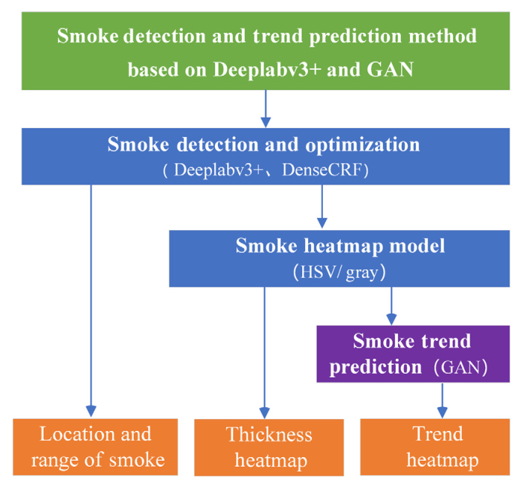
Method
Shuhong Cheng, Jiyong Ma, and Shijun Zhang "Smoke detection and trend prediction method based on Deeplabv3+ and generative adversarial network," Journal of Electronic Imaging 28(3), 033006 (14 May 2019).
方法流程

Slide 4
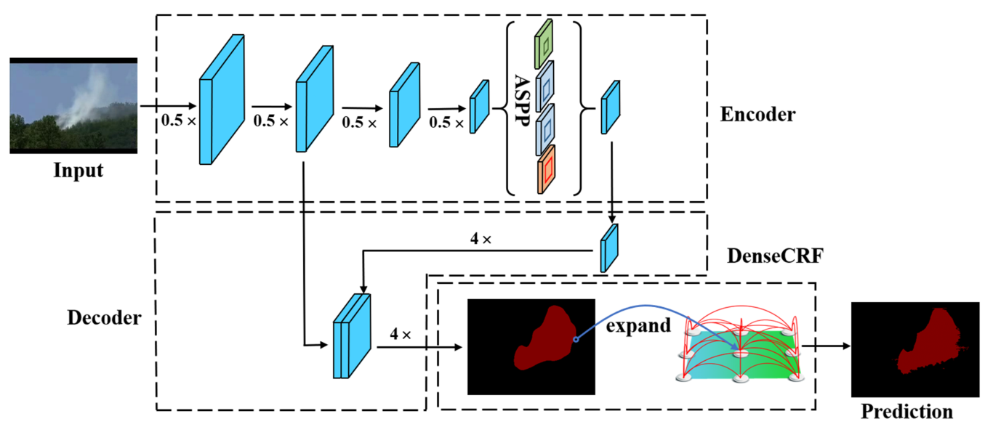
Architecture
Shuhong Cheng, Jiyong Ma, and Shijun Zhang "Smoke detection and trend prediction method based on Deeplabv3+ and generative adversarial network," Journal of Electronic Imaging 28(3), 033006 (14 May 2019).
Backbone: DeepLabV3+
ASPP 使用深度可分卷积
DenseCRF 后处理

Slide 5




DenseCRF
Shuhong Cheng, Jiyong Ma, and Shijun Zhang "Smoke detection and trend prediction method based on Deeplabv3+ and generative adversarial network," Journal of Electronic Imaging 28(3), 033006 (14 May 2019).
使用 CRF（Conditional Random Field） 来建立任意像素间的关系。CRF 使用烟雾边缘像素作为节点，像素间关系作为边。
CRF 遵循 Gibbs 分布，E 为能量函数：
E 中包含一元项和二元项：
一元势能项表示像素 x_i 的预测结果，二元势能项表示像素 x_i 和其他烟雾边缘像素 x_j 的关系。
μ(x_i, x_j) 表示两个像素间的结合力，k^(m)(f_i, f_j) 表示两个像素间的亲密度。

Slide 6
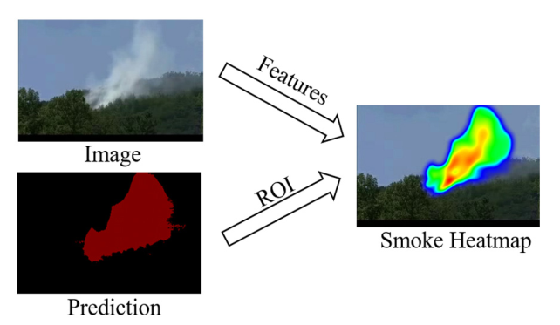
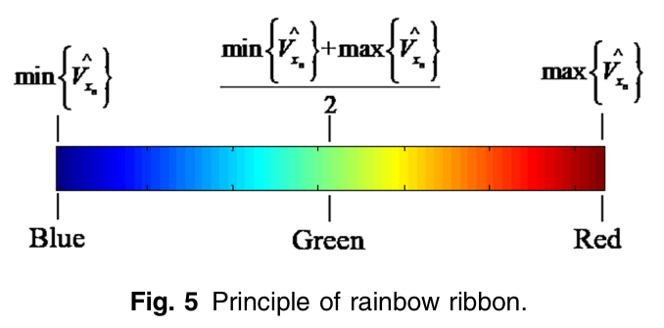
Heatmap
Shuhong Cheng, Jiyong Ma, and Shijun Zhang "Smoke detection and trend prediction method based on Deeplabv3+ and generative adversarial network," Journal of Electronic Imaging 28(3), 033006 (14 May 2019).
选取 HSV 和灰度特征来表征烟雾的浓度特征。基于 HSV 的烟雾热图原理如下:
1. 烟雾分割方法预测烟雾区域 U，区域包含 n 个像素。
2. 对像素 x_i 设置半径为 10 的缓冲区。
3. 计算像素 x_i 在原始烟雾图像对应位置的 V 值（HSV 的第三个通道值），V=max(R,G,B)。
4. min-max 归一化 。
5. 像素 x_i 根据彩虹色带填入缓冲区。

Slide 7
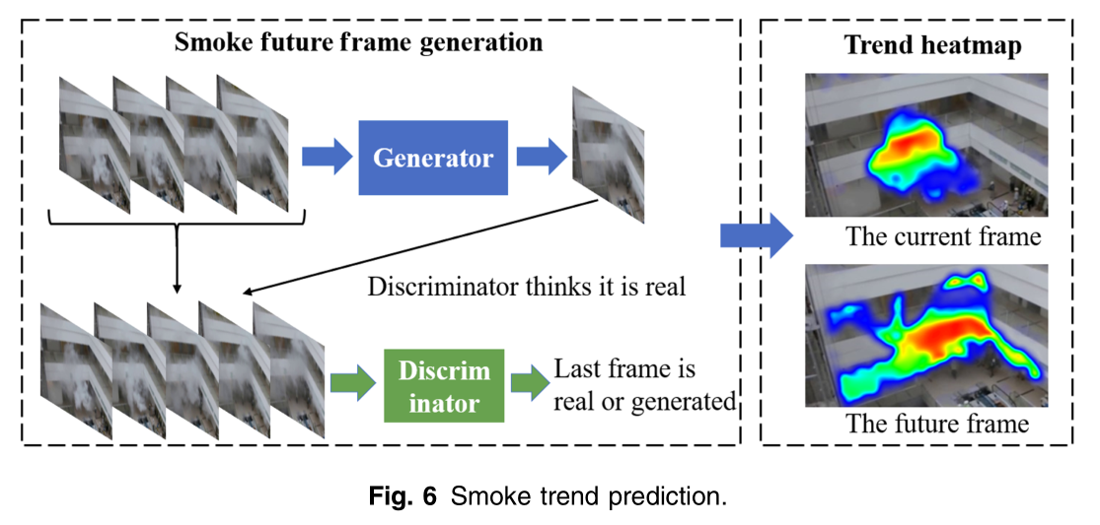
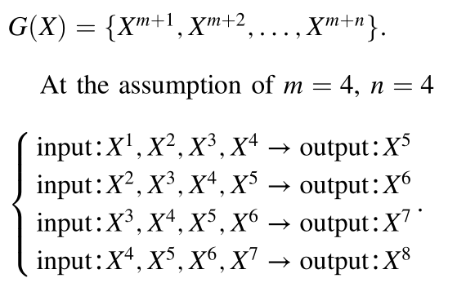
Trend
Prediction
Shuhong Cheng, Jiyong Ma, and Shijun Zhang "Smoke detection and trend prediction method based on Deeplabv3+ and generative adversarial network," Journal of Electronic Imaging 28(3), 033006 (14 May 2019).
生成器输入是 m 帧的视频序列，X_g 是生成的视频帧。迭代生成 X_g。

Slide 8
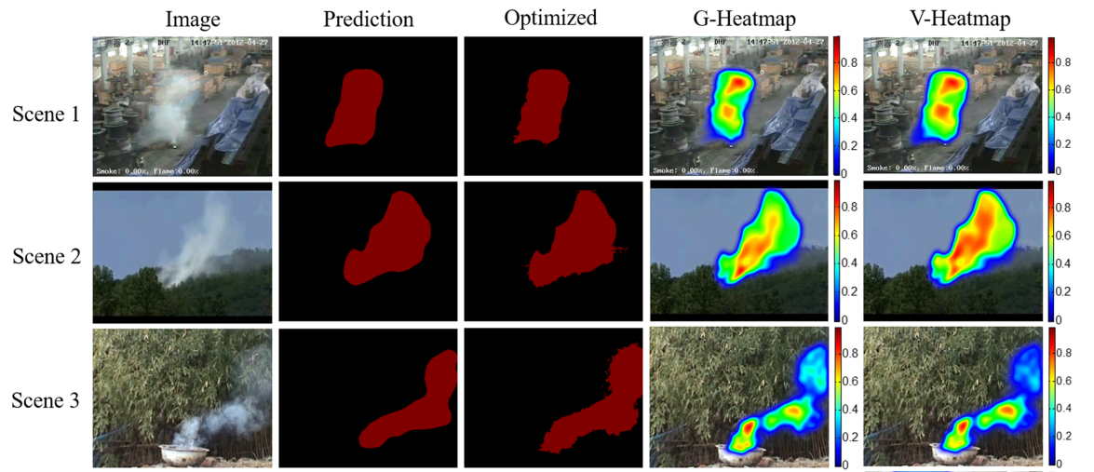
Segmentation
Experiment
Shuhong Cheng, Jiyong Ma, and Shijun Zhang "Smoke detection and trend prediction method based on Deeplabv3+ and generative adversarial network," Journal of Electronic Imaging 28(3), 033006 (14 May 2019).

Slide 9
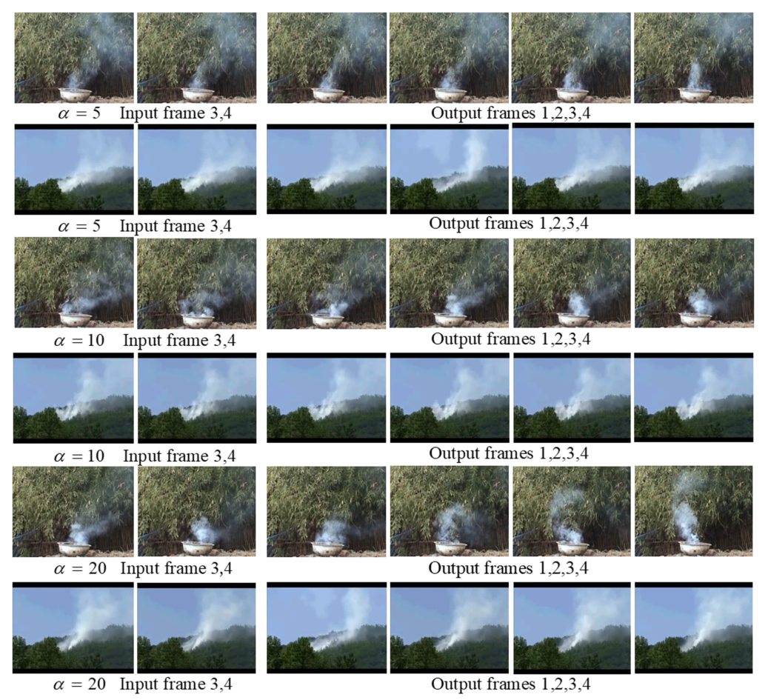
Generation
Experiment
Shuhong Cheng, Jiyong Ma, and Shijun Zhang "Smoke detection and trend prediction method based on Deeplabv3+ and generative adversarial network," Journal of Electronic Imaging 28(3), 033006 (14 May 2019).

Slide 10

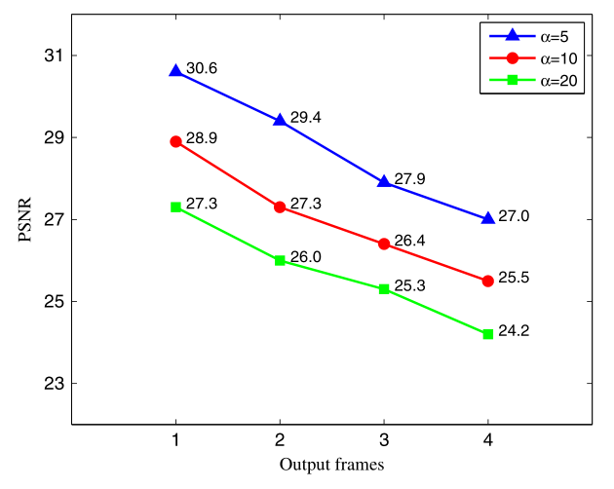
Metric
Shuhong Cheng, Jiyong Ma, and Shijun Zhang "Smoke detection and trend prediction method based on Deeplabv3+ and generative adversarial network," Journal of Electronic Imaging 28(3), 033006 (14 May 2019).
使用峰值信噪比来度量生成的烟雾质量：
a=5 或 10 时，质量好，但是帧间运动状态变化不大。
a=20 时质量差，但是帧间运动状态变化明显，可以有效表达短期烟雾趋势。

